Slide 1


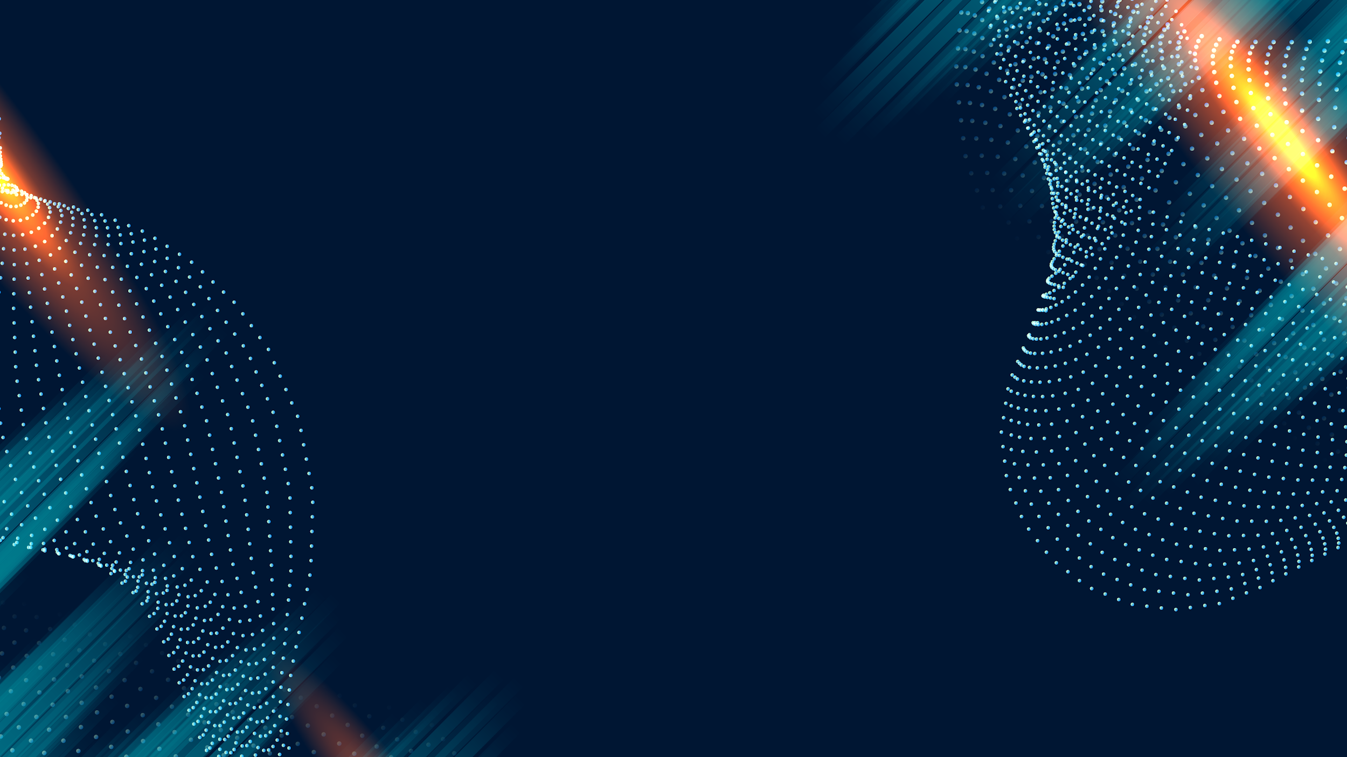
Skeleton-Based Anomaly Detection in Citation Networks
Using Hyperbolic Geometry and Neural ODEs
25-2-R-2
Problem Statement
Presented by:
Omer Goldstein 205906258
Ido Sakal 316139351
Supervisor:
Dr. Dvora Toledano Kitai

Slide 2
Skeleton-Based Anomaly Detection in Citation Networks
Using Hyperbolic Geometry and
Neural ODEs
25-2-R-2
Citation networks are hierarchical and dynamic
Traditional static models fail to capture this temporal evolution, offering only snapshot views.
Existing methods struggle with:
Capturing hierarchy
Modeling temporal evolution
Detecting unexpected citation patterns
Problem Statement
Presented by:
Omer Goldstein 205906258
Ido Sakal 316139351
Supervisor:
Dr. Dvora Toledano Kitai

Slide 3

Citation networks are hierarchical and dynamic
Traditional static models fail to capture this temporal evolution, offering only snapshot views.
Existing methods struggle with:
Capturing hierarchy
Modeling temporal evolution
Detecting unexpected citation patterns
Motivation
Problem Statement
1
Notes:
Citation networks are not static — they grow and evolve. However, many models treat them as fixed graphs, ignoring the dynamics. This limits our ability to detect meaningful changes.

Slide 4
Citation networks are hierarchical and dynamic
Traditional static models fail to capture this temporal evolution, offering only snapshot views.
Existing methods struggle with:
Capturing hierarchy
Modeling temporal evolution
Detecting unexpected citation patterns
Motivation
Understand how Scholarly evolves in science
Detect irregular citation behaviors over time
Improve modeling of dynamic, hierarchical networks
Support trend discovery and scholarly impact analysis
Problem Statement

Slide 5
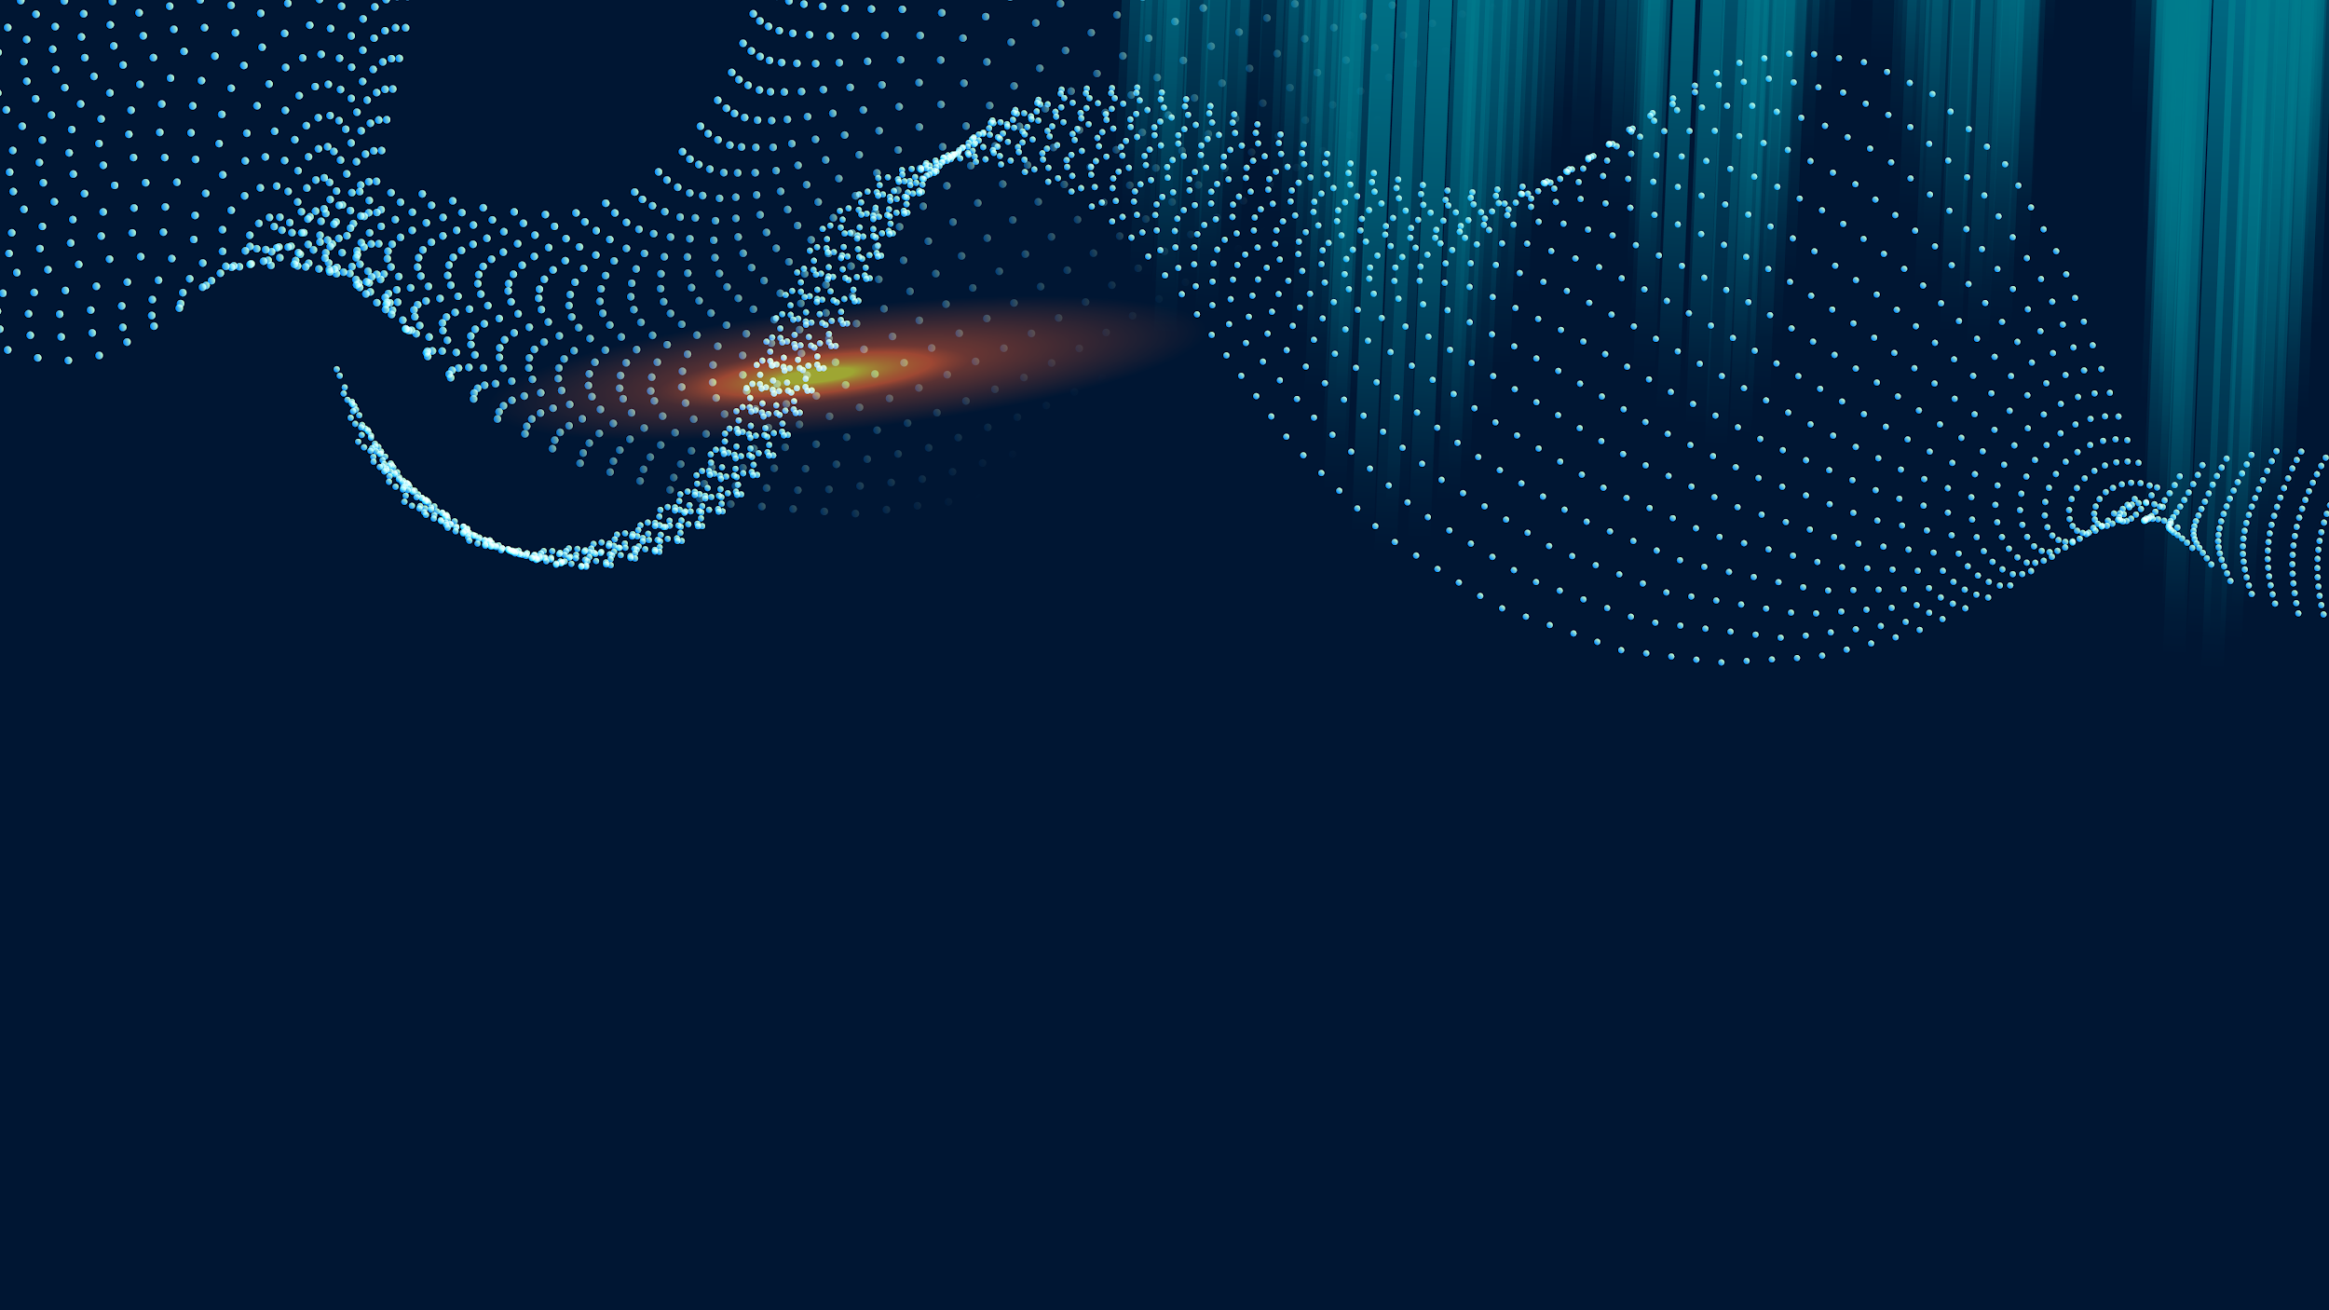
Understand how Scholarly evolves in science
Detect irregular citation behaviors over time
Improve modeling of dynamic, hierarchical networks
Support trend discovery and scholarly impact analysis
Current State & Limitations
Motivation
2
Notes:
Understanding how the network evolves is key. We’re motivated by the need to detect unusual citation behavior

Slide 6
Existing Approaches Fall Short
Static analysis: misses temporal evolution
Euclidean embeddings: distort hierarchical structures
Discrete-time models: oversimplify dynamics
Weak anomaly detection: limited temporal insight
Understand how Scholarly evolves in science
Detect irregular citation behaviors over time
Improve modeling of dynamic, hierarchical networks
Support trend discovery and scholarly impact analysis
Current State & Limitations
Motivation

Slide 7
Existing Approaches Fall Short
Static analysis: misses temporal evolution
Euclidean embeddings: distort hierarchical structures
Discrete-time models: oversimplify dynamics
Weak anomaly detection: limited temporal insight
Theoretical Foundation
Current State & Limitations
3
Notes:
As we mentioned, current methods struggle with certain challenges,
and they also have additional technical problems:
1) Euclidean embeddings distort hierarchical structures.
2) discrete-time models can't track how networks evolve over time.
These approaches oversimplify complex dynamic patterns
3) and current anomaly detection methods miss the context needed for proper analysis.
This is why we need a different approach.

Slide 8

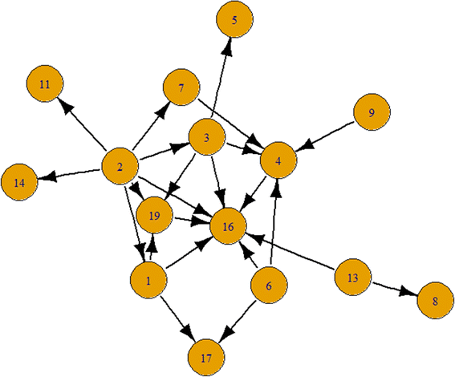
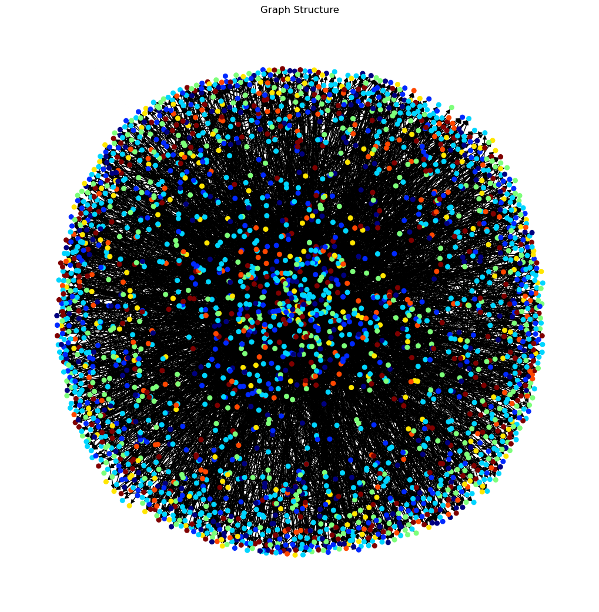
Theoretical Foundation
A citation network is a directed graph where:
Nodes represent academic papers.
Edges represent citations, pointing from the citing paper to the cited paper.
The network is dynamic, as it evolves over time with new papers and citations.
Properties
Citation Network
Mathematical Tools
Hyperbolic Geometry
DISKNET

Slide 9
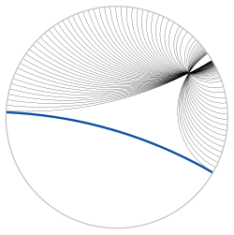
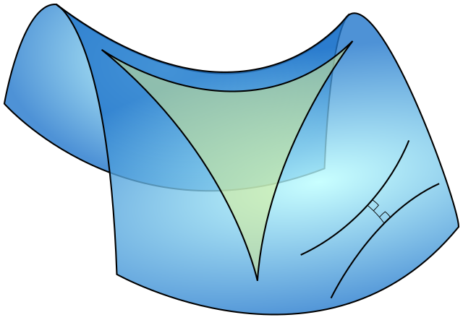
A citation network is a directed graph where:
Nodes represent academic papers.
Edges represent citations, pointing from the citing paper to the cited paper.
The network is dynamic, as it evolves over time with new papers and citations.
Theoretical Foundation
Citation Network
Hyperbolic Geometry
4
Hyperbolic Geometry is Non-Euclidean geometry with constant negative curvature, where:
Parallel lines diverge
Triangle angles < 180°
Space expand exponentially from the center
Visual Analogy: saddle shape
Properties
Mathematical Tools
DISKNET
Notes:
Now to understand our model, we need to cover its key theoretical components.
Citation networks are directed graphs - papers as nodes, citations as edges pointing from citing paper to cited paper.
What's important is that these networks grow exponentially as new papers and citations keep getting added.
This brings us to the geometric framework we use to analyze them effectively.

Slide 10
A citation network is a directed graph where:
Nodes represent academic papers.
Edges represent citations, pointing from the citing paper to the cited paper.
The network is dynamic, as it evolves over time with new papers and citations.
Citation Network
Hyperbolic Geometry is Non-Euclidean geometry with constant negative curvature, where:
Parallel lines diverge
Triangle angles < 180°
Space expand exponentially from the center
Visual Analogy: saddle shape
Theoretical Foundation
Hyperbolic Geometry
Properties
Mathematical Tools
5
DISKNET
Why it fits citation networks?
Matches citation spread via exponential growth
Preserves hierarchy
Supports scale-free, tree-like networks
Less distortion than Euclidean embeddings
Core Components
ANOMALY DETECTION
Notes:
This geometric framework has constant negative curvature.
Key properties include parallel lines that diverge, triangle angles less than 180 degrees, and space that expands exponentially from the center.

Slide 11

Hyperbolic Geometry is Non-Euclidean geometry with constant negative curvature, where:
Parallel lines diverge
Triangle angles < 180°
Space expand exponentially from the center
Visual Analogy: saddle shape
Citation Network
Why it fits citation networks?
Matches citation spread via exponential growth
Preserves hierarchy
Supports scale-free, tree-like networks
Less distortion than Euclidean embeddings
Hyperbolic Geometry
Theoretical Foundation
Properties
Mathematical Tools
DISKNET
6
Core Components
Mathematical Tools for Our Framework:
$H^{ n,c}=\left\{ x ∈ ℝ^{ n} \right| \left\|x\right\|<\frac{1}{\sqrt{\left|c\right|}}\}$ $, c<0$
$d_{H}^{c}\left(x,y\right)=\frac{1}{\sqrt{\left|c\right|}}⋅arccosh\left(1−\frac{2c⋅{\left\|x−y\right\|}^{2}}{\left(1+c{\left\|x\right\|}^{2}\right)\left(1+c{\left\|y\right\|}^{2}\right)}\right), c<0$
$x⊕_{c}y=\left(\frac{\left(1+2c⋅\left\langle x,y\right\rangle +c⋅{\left\|y\right\|}^{2}\right)⋅x+\left(1−c⋅{\left\|x\right\|}^{2}\right)⋅y}{1+2c⋅\left\langle x,y\right\rangle +c^{2}⋅{\left\|x\right\|}^{2}⋅{\left\|y\right\|}^{2}}\right), c<0$
$\log_{z}^{c}\left(θ^{H}\right)=θ_{z}^{E}=\frac{2}{\sqrt{\left|c\right|}⋅λ_{z}^{c}}⋅arctanh\left(\sqrt{\left|c\right|}⋅\left\|−z⊕_{c}θ^{H}\right\|\right)⋅\frac{−z⊕_{c}θ^{H}}{\left\|−z⊕_{c}θ^{H}\right\|}$
$λ_{z}^{c}=\frac{2}{1+c⋅{\left\|z\right\|}^{2}}$
ANOMALY DETECTION
Notes:
We chose this framework because hyperbolic space naturally matches citation network behavior.
It captures the exponential growth patterns in citations and preserves hierarchical academic structures with much less distortion than traditional Euclidean approaches.

Slide 12
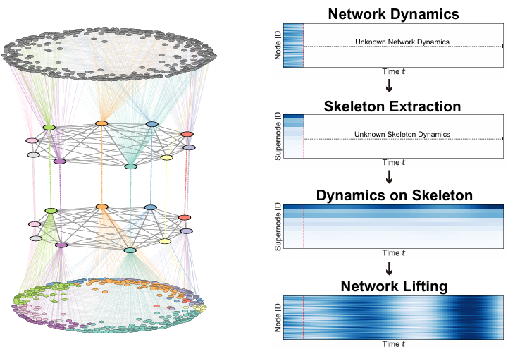

Why it fits citation networks?
Matches citation spread via exponential growth
Preserves hierarchy
Supports scale-free, tree-like networks
Less distortion than Euclidean embeddings
CITATION NETWORK
Mathematical Tools for Our Framework:
$H^{ n,c}=\left\{ x ∈ ℝ^{ n} \right| \left\|x\right\|<\frac{1}{\sqrt{\left|c\right|}}\}$ $, c<0$
$d_{H}^{c}\left(x,y\right)=\frac{1}{\sqrt{\left|c\right|}}⋅arccosh\left(1−\frac{2c⋅{\left\|x−y\right\|}^{2}}{\left(1+c{\left\|x\right\|}^{2}\right)\left(1+c{\left\|y\right\|}^{2}\right)}\right), c<0$
$x⊕_{c}y=\left(\frac{\left(1+2c⋅\left\langle x,y\right\rangle +c⋅{\left\|y\right\|}^{2}\right)⋅x+\left(1−c⋅{\left\|x\right\|}^{2}\right)⋅y}{1+2c⋅\left\langle x,y\right\rangle +c^{2}⋅{\left\|x\right\|}^{2}⋅{\left\|y\right\|}^{2}}\right), c<0$
$\log_{z}^{c}\left(θ^{H}\right)=θ_{z}^{E}=\frac{2}{\sqrt{\left|c\right|}⋅λ_{z}^{c}}⋅arctanh\left(\sqrt{\left|c\right|}⋅\left\|−z⊕_{c}θ^{H}\right\|\right)⋅\frac{−z⊕_{c}θ^{H}}{\left\|−z⊕_{c}θ^{H}\right\|}$
$λ_{z}^{c}=\frac{2}{1+c⋅{\left\|z\right\|}^{2}}$
Hyperbolic Geometry
Theoretical Foundation
Properties
Mathematical Tools
DISKNET
Core Components
7
DISKNET: Dynamics- Invariant Skeleton Neural Network
Goal: Capture long-term dynamics of complex networks through simplified, stable skeletons
Anomaly
Detection
Notes:
1. Definition of the Hyperbolic Space
This defines the Poincaré ball model of hyperbolic space in dimension n, with curvature c<0
∥x∥: Euclidean norm of vector x.
The ball has radius 1/sqrt(|c|), vectors in this space must lie strictly inside this radius.
🔶 2. Hyperbolic Distance Function
Measures the distance between two points x and y in hyperbolic space.
This formula adjusts Euclidean distance into a form consistent with negative curvature, accounting for distortion due to hyperbolic geometry.
🔶 3. Möbius Addition (Binary Operation in Hyperbolic Space)
Purpose: This is the "addition" operation in hyperbolic space, analogous to vector addition in Euclidean space.
Effect: Combines two vectors in a way that respects the curvature of hyperbolic space.
Used in: Translating points, or operations like centering or motion within hyperbolic embeddings.
🔶 4. Logarithmic Map from Hyperbolic to Euclidean Space
Purpose: Maps a point from the hyperbolic space back into the Euclidean tangent space at point z.
Normalization: The vector is normalized to unit direction and scaled by the hyperbolic magnitude.
🔶 5. Conformal Factor
Purpose: A scaling factor used to adjust vectors when mapping between spaces (e.g., in the logarithmic map).
∥z∥: Euclidean norm of the base point z.
Effect: Accounts for distortion introduced by curvature; ensures distance preservation in tangent space approximations.

Slide 13

Mathematical Tools for Our Framework:
$H^{ n,c}=\left\{ x ∈ ℝ^{ n} \right| \left\|x\right\|<\frac{1}{\sqrt{\left|c\right|}}\}$ $, c<0$
$d_{H}^{c}\left(x,y\right)=\frac{1}{\sqrt{\left|c\right|}}⋅arccosh\left(1−\frac{2c⋅{\left\|x−y\right\|}^{2}}{\left(1+c{\left\|x\right\|}^{2}\right)\left(1+c{\left\|y\right\|}^{2}\right)}\right), c<0$
$x⊕_{c}y=\left(\frac{\left(1+2c⋅\left\langle x,y\right\rangle +c⋅{\left\|y\right\|}^{2}\right)⋅x+\left(1−c⋅{\left\|x\right\|}^{2}\right)⋅y}{1+2c⋅\left\langle x,y\right\rangle +c^{2}⋅{\left\|x\right\|}^{2}⋅{\left\|y\right\|}^{2}}\right), c<0$
$\log_{z}^{c}\left(θ^{H}\right)=θ_{z}^{E}=\frac{2}{\sqrt{\left|c\right|}⋅λ_{z}^{c}}⋅arctanh\left(\sqrt{\left|c\right|}⋅\left\|−z⊕_{c}θ^{H}\right\|\right)⋅\frac{−z⊕_{c}θ^{H}}{\left\|−z⊕_{c}θ^{H}\right\|}$
$λ_{z}^{c}=\frac{2}{1+c⋅{\left\|z\right\|}^{2}}$
CITATION NETWORK
Hyperbolic Geometry
DISKNET: Dynamics- Invariant Skeleton Neural Network
Goal: Capture long-term dynamics of complex networks through simplified, stable skeletons
Theoretical Foundation
DISKNET
Core Components
Anomaly
Detection
8
Skeleton Extraction: Extract a simplified
dynamic skeleton preserving the core structure.
Super-Resolution Reconstruction: Reconstructs the full network dynamics.
Skeleton Dynamics Modeling: Apply Neural ODEs on the skeleton.

Slide 14
DISKNET: Dynamics- Invariant Skeleton Neural Network
Goal: Capture long-term dynamics of complex networks through simplified, stable skeletons
CITATION NETWORK
Hyperbolic Geometry
Skeleton Extraction: Extract a simplified
dynamic skeleton preserving the core structure.
Super-Resolution Reconstruction: Reconstructs the full network dynamics.
DISKNET
Theoretical Foundation
Core Components
Skeleton Dynamics Modeling: Apply Neural ODEs on the skeleton.
Anomaly
Detection
Isolation Forest
9
Anomaly Detection is the process of identifying rare, unusual, or suspicious patterns in data that deviate significantly from the norm.
In Citation Networks, anomalies may include:
Unexpected citation links between unrelated research areas.
Sudden citation bursts to low-visibility papers.
Structural inconsistencies in evolving graphs.
Isolation Forest
Notes:
להזכיר בעל פה שהמודל במקור מועד לזיהוי דינמיקות ארוכות גרף ואנו עושים לו אדפטציה לזיהוי אנומליות
Skeleton Extraction – identify the stable structure across time. Given a dynamic graph over multiple time steps identifying nodes and edges that persist across time.
Neural ODE Modeling – learn the dynamics using continuous-time methods. Instead of modeling discrete jumps, it solves a differential equation
Super-Resolution Reconstruction – recover the full network from the skeleton.

Slide 15
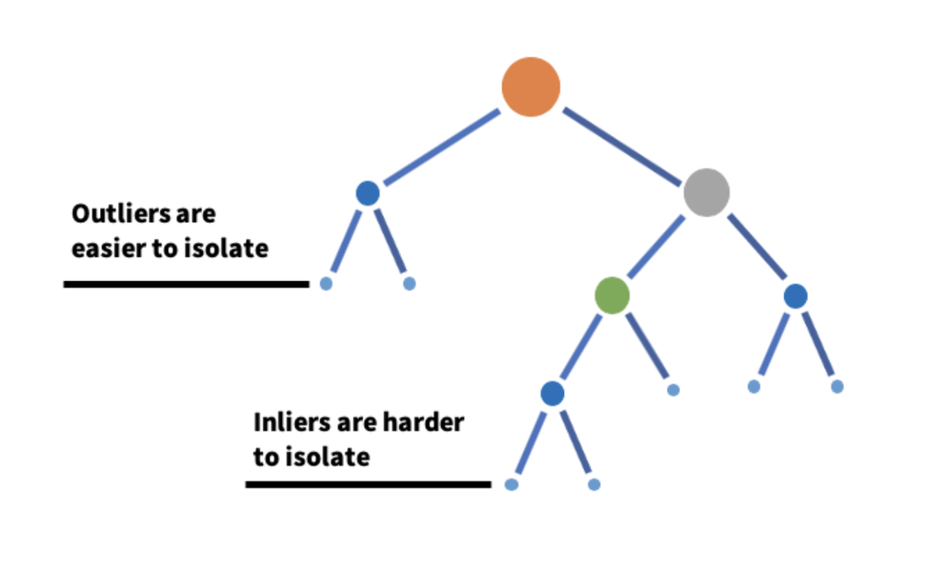
Skeleton Extraction: Extract a simplified
dynamic skeleton preserving the core structure.
Super-Resolution Reconstruction: Reconstructs the full network dynamics.
Skeleton Dynamics Modeling: Apply Neural ODEs on the skeleton.
CITATION NETWORK
Hyperbolic Geometry
Anomaly Detection is the process of identifying rare, unusual, or suspicious patterns in data that deviate significantly from the norm.
In Citation Networks, anomalies may include:
Unexpected citation links between unrelated research areas.
Sudden citation bursts to low-visibility papers.
Structural inconsistencies in evolving graphs.
DISKNET
Theoretical Foundation
Anomaly
Detection
Isolation Forest
10
An unsupervised machine learning algorithm specifically designed for anomaly detection.
How It Works:
Randomly build multiple binary trees by splitting features
Measure how quickly a data point is isolated
Points with shorter paths (fewer splits) are more likely to be anomalies
Notes:
Anomaly detection identifies unusual patterns that deviate from the norm.
In citation networks, this means detecting unexpected behaviors like cross-domain citations - for instance, when a machine-learning paper suddenly gets cited in physics - or sudden citation bursts, like 'sleeping beauty' papers that get rediscovered and suddenly receive massive attention after years of being ignored.

Slide 16
Anomaly Detection is the process of identifying rare, unusual, or suspicious patterns in data that deviate significantly from the norm.
In Citation Networks, anomalies may include:
Unexpected citation links between unrelated research areas.
Sudden citation bursts to low-visibility papers.
Structural inconsistencies in evolving graphs.
Hyperbolic Geometry
DISKNET
An unsupervised machine learning algorithm specifically designed for anomaly detection.
How It Works:
Randomly build multiple binary trees by splitting features
Measure how quickly a data point is isolated
Points with shorter paths (fewer splits) are more likely to be anomalies
Anomaly
Detection
Theoretical Foundation
Isolation Forest
11
Notes:
For our anomaly detection approach, we use Isolation Forest - an unsupervised algorithm that identifies outliers by measuring how easily data points can be isolated from the rest.

Slide 17

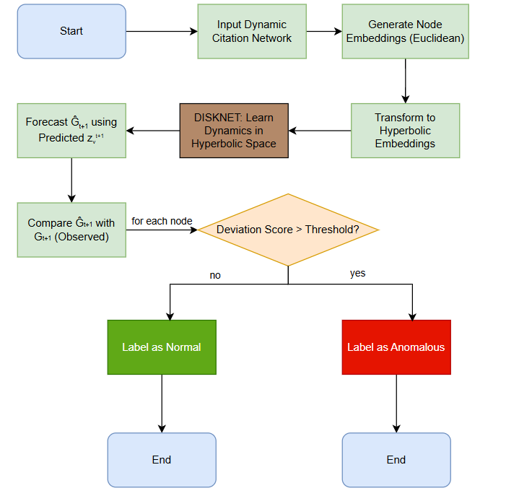
Methodology
Model Pipeline
Validation Strategy
Validation Process Pipeline

Slide 18
Methodology
Model Pipeline
Validation Strategy
12
Controlled Testing Approach
Synthetic anomaly injection: 5-10% artificial nodes
Random citation patterns: 30% connectivity to existing nodes
Iterative validation: K independent runs
Metrics: Precision & Recall measurement
Validation Process Pipeline
Notes:
With these key pieces in place, here's how our approach works.
Our pipeline has several key stages: We start by generating node embeddings using standard techniques, then transform these into hyperbolic space. DISKNET learns the dynamics in this hyperbolic representation and forecasts future positions. We then reconstruct the predicted network and compare it with the actual observed network. For each node, we calculate a deviation score - if this score exceeds our threshold, we label it as anomalous, otherwise it's normal.

Slide 19
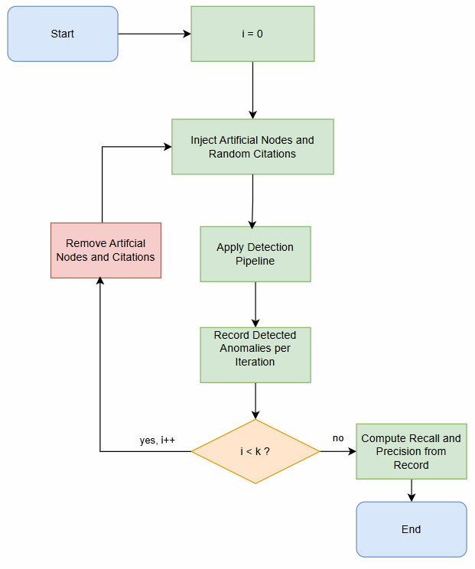
Model Pipeline
Controlled Testing Approach
Synthetic anomaly injection: 5-10% artificial nodes
Random citation patterns: 30% connectivity to existing nodes
Iterative validation: K independent runs
Metrics: Precision & Recall measurement
Methodology
Validation Strategy
Validation Process Pipeline
13
Notes:
Precision measures how many of the detected anomalies are actually true anomalies.
Recall measures how many of the real anomalies our model actually detects.
In our case, we aim for both to be high, ensuring that we catch real anomalies without overwhelming noise.

Slide 20
Controlled Testing Approach
Synthetic anomaly injection: 5-10% artificial nodes
Random citation patterns: 30% connectivity to existing nodes
Iterative validation: K independent runs
Metrics: Precision & Recall measurement
Model Pipeline
Validation Strategy
Methodology
Validation Process Pipeline
14

Slide 21

Precision: ~80%
Recall: ~85%
Forecasting Quality: Robust detection of anomalous citation behaviors.
Expected Results

Slide 22
Precision: ~80%
Recall: ~85%
Forecasting Quality: Robust detection of anomalous citation behaviors.
Expected Results
Performance Targets
Anticipated Discoveries
15
Delayed recognition patterns
Unexpected Cross-Domain Citations
Structural deviation identification
Notes:
Based on the results of DISKNET we are expecting to get both accurate and comprehensive results finding anomalies.
(if needed) Precision measures how many of our detected anomalies are actually correct, while recall shows how many real anomalies we catch.

Slide 23
Precision: ~80%
Recall: ~85%
Forecasting Quality: Robust detection of anomalous citation behaviors.
Performance Targets
Delayed recognition patterns
Unexpected Cross-Domain Citations
Structural deviation identification
Expected Results
Anticipated Discoveries
16
Notes:
Based on our validation results, we anticipate successfully detecting the types of anomalies we described earlier - delayed recognition patterns, cross-domain citations, and structural deviations.

Slide 24
Design Challenges
Geometric Framework: Hyperbolic space better captures hierarchical and scale-free structure but introduces added complexity that required careful theoretical grounding and adaptation.
Anomaly Definition: Defining what constitutes "anomalous" citation behavior over time is nontrivial and requires domain knowledge + temporal reasoning.
Robustness to Noise: Requires methods that avoid overfitting to short-term noise fluctuations in citation data.

Slide 25
Geometric Framework: Hyperbolic space better captures hierarchical and scale-free structure but introduces added complexity that required careful theoretical grounding and adaptation.
Anomaly Definition: Defining what constitutes "anomalous" citation behavior over time is nontrivial and requires domain knowledge + temporal reasoning.
Robustness to Noise: Requires methods that avoid overfitting to short-term noise fluctuations in citation data.
Design Challenges
17
Notes:
We faced several challenges: First, using hyperbolic space requires careful mathematical handling. Second, defining what counts as an anomaly isn’t trivial. Finally, we had to ensure our method wasn’t overly sensitive to noise

Slide 26



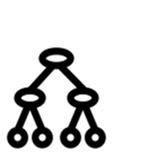


Technical Architecture
Language | Core Libraries | Hyperbolic Operations
Python | PyTorch, torchdiffeq, NetworkX | Geoopt
Anomaly Detection | Environment | Dataset
Isolation Forest (scikit-learn) | Google Colab Pro | OpenAlex

Slide 27
Technical Architecture
Language | Core Libraries | Hyperbolic Operations
Python | PyTorch, torchdiffeq, NetworkX | Geoopt
Anomaly Detection | Environment | Dataset
Isolation Forest (scikit-learn) | Google Colab Pro | OpenAlex
18

Slide 28
Innovation & Contribution
Application of Skeleton-based approach for citation anomaly detection.
By that improving the capability to predict anomalies.
Continuous-time modeling of citation dynamics.

Slide 29
Application of Skeleton-based approach for citation anomaly detection.
By that improving the capability to predict anomalies.
Continuous-time modeling of citation dynamics.
Innovation & Contribution
19
Notes:
Our contributions include adapting DISKNET integration of hyperbolic geometry with neural ODEs for anomaly detection and applying this to citation networks using a skeleton-based framework.
This provides a more realistic model of citation behavior over time.

Slide 30
Problem: Citation networks evolve dynamically, but current static models miss temporal patterns and fail to detect anomalous citation behaviors
Solution: Skeleton-based framework using hyperbolic geometry + Neural ODEs to model continuous citation dynamics and detect deviations
Impact: Enhanced scholarly influence analysis, research trend identification, and understanding of knowledge propagation dynamics
Summary

Slide 31
THANKS!
Problem: Citation networks evolve dynamically, but current static models miss temporal patterns and fail to detect anomalous citation behaviors
Solution: Skeleton-based framework using hyperbolic geometry + Neural ODEs to model continuous citation dynamics and detect deviations
Impact: Enhanced scholarly influence analysis, research trend identification, and understanding of knowledge propagation dynamics
Summary
20
Do you
have any questions?
Notes:
To summarize: Traditional models miss how citation networks evolve.
We introduce a new skeleton-based framework using hyperbolic space and Neural ODEs.
This enables better detection of anomalies and deeper insights into research evolution

Slide 32
THANKS!
Do you
have any questions?
21

